Slide 1
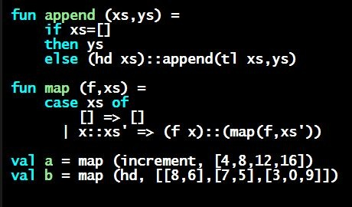
Programming Languages Dan Grossman University of Washington
Optional: Who I am / Acknowledgments

Slide 2
Optional viewing!
I thought some of you might be curious about who I am since you will be spending so many hours listening to me…
… and I want to acknowledge everyone not in front of the camera

Slide 3
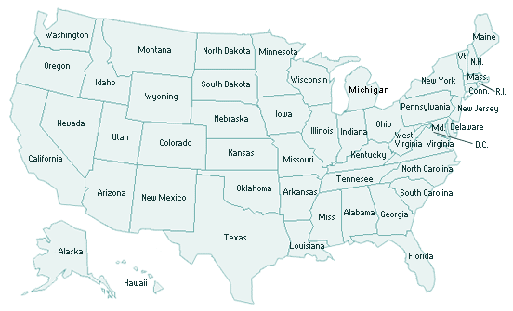
Where I am from
Cornell Univ.
Ithaca
1997-2003
Univ. Washington
Seattle
2003-present
St. Louis 1975-1993
Rice Univ.
Houston
1993-1997

Slide 4
My research: “from Greek to graphs”
Use the fundamental elegance of PL…
Functional languages, type systems, logic, proofs, …
Formal semantics is very, very beautiful – and very useful
… to improve modern technology trends
Systems programming
Multicore
Power limitations
… [much more]
A powerful and fulfilling strategy: Collaborate with others, bringing precision, formalism, and language structure
Also: Focus on CS education (curriculum, PL, etc.)

Slide 5
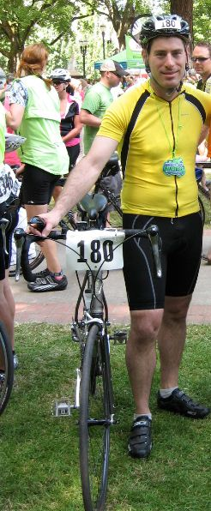
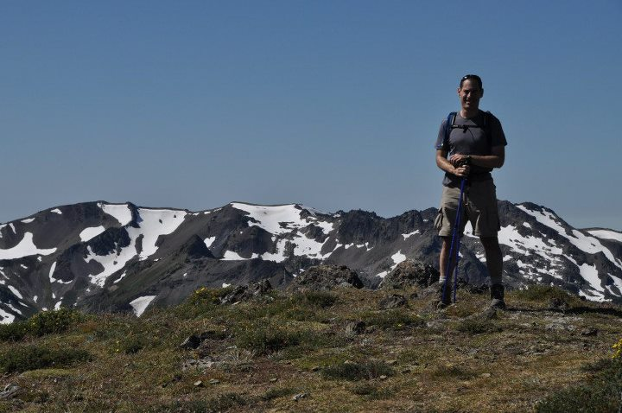
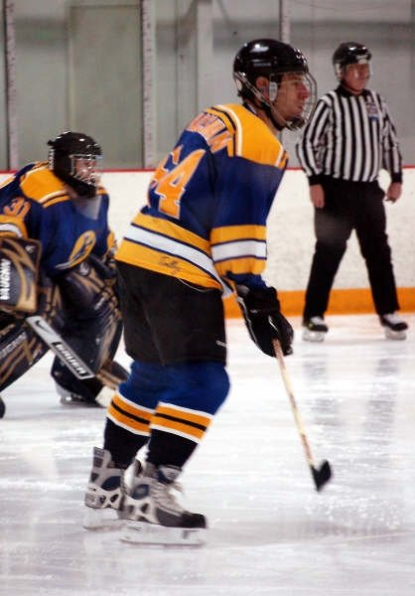
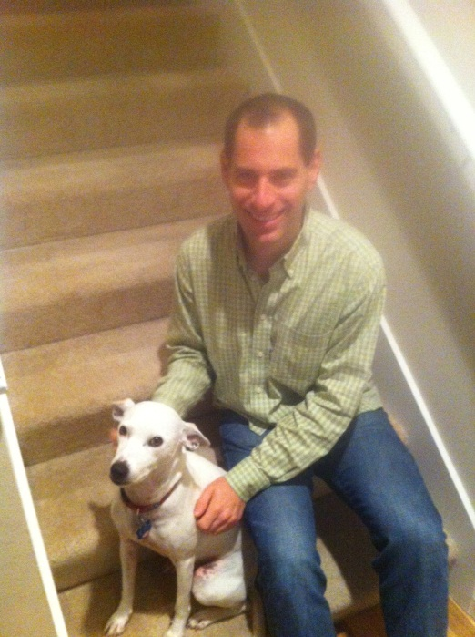
The old me [until 2013…]

Slide 6
Where I have been
Countries:
Vatican City, Monaco, St. Lucia, Luxembourg, Bahamas, Israel, Switzerland, Estonia, Ireland, Italy, Norway, Germany, Japan, Sweden, Spain, France, Tanzania, South Africa, Mexico, India, China, United States, Canada, Russia
U.S. States:
All except Alaska, Delaware

Slide 7
The new me
Kid #1: December 2013
Kid #2: September 2015
Most of this MOOC was created before that ☺
As was most of my sleeping ☺ ☺

Slide 8
Acknowledgments [so far!]
Initial TA crew: Cody S., Rachel S., Sean W., Claire M., Eric M., Max F.
In Summer/Fall 2012, it was “the wild west”
Later TAs: Amaris C., Max S., Trevor K.
Platform migration: Brett B., Ben E., Lauren W.
Community Mentors: Sean C., Jan G., Alexander K., Pavel L., Jeffrey M., Connor O., Stephen P., Peter E., Andreas P., Haris S.
A/V: Rod P., Fred V.
Coursera: Anne T., Conner D., Pang Wei K., Allison F., Sabah B., Meera R., Tovah K., …

Slide 9
And more!
Special tech help at crucial times: Ben W., Stefan M., John R., Sam H.
All the TAs, faculty, and colleagues that contributed to the material we draw from over the years
Alan B., Craig C., Stuart R., Lydia D.
[and dozens (hundreds?) more]
And the 1000s of students so far!

